Slide 1

FEED ARCHITECTURE · CASE STUDY
Varsity: how a campus feed decides what you see
A multi-stage hybrid recommender inspired by X's open-source pipeline, built for real-time campus scale.
PIPELINE SPEC · PRODUCTION V1
Notes:
Introduce Varsity: a multi-stage hybrid campus feed recommender modeled on modern social architectures. The goal is to deliver relevant, fresh, and diverse content in milliseconds.

Slide 2
DATASET & OPERATING SCALE
The setup: 400 students, 3,500 posts, 22,000+ interactions
STUDENT COMMUNITY
CANDIDATE POOL
LOGGED SIGNALS
400
3,500
22k+
Follow network with hub accounts and long-tail lurkers
Active corpus across department updates, clubs, and peer posts
Likes, replies, bookmarks, and dwell-measured skips
TARGET LATENCY
RECOMMENDATION GOAL
Real-time delivery (< 50ms end-to-end)
Select the top-10 posts per student per request
TECHNICAL REPORT · REV A
02 / 10
Notes:
Walk through the environment numbers: 400 students create realistic power-law network dynamics. 3,500 posts need fast filtering down to just 10 high-relevance items.

Slide 3
CORE ARCHITECTURE
Every feed request runs a four-stage funnel
Progressive narrowing from 3,500 candidates down to 10 balanced items. Sourcing completes in under 5ms.
POOL
→
STAGE 1
→
STAGE 2
→
STAGE 3
→
STAGE 4
3,500 Posts
~350
Candidate Retrieval
12
Feature Hydration
1
Heavy Ranker
10
MMR Diversity Mixer
Active corpus
A score per post
~350 posts (<5ms)
12 numbers per post
Top-10 feed
STAGE 1 VOLUME
STAGE 2 ENRICHMENT
FINAL OUTPUT
3,500 → 350
12 features / post
Top-10 diversified
TECHNICAL REPORT · REV A
03 / 10
Notes:
Point out the 10x funnel at Stage 1: retrieving 350 candidates in under 5ms makes heavy scoring computationally feasible for the remaining stages.

Slide 4
RETRIEVAL & REPRESENTATION
Stages 1 and 2: gather ~350 candidates, then describe each one
Four parallel sourcing pathways merge before 12-dimensional feature hydration.
IN-NETWORK GRAPH
IALS FACTORS
NEURAL CF
CONTENT TF-IDF
150 Posts
100 Posts
100 Posts
50 Posts
Follow graph random walks
Matrix factorization retrieval
Non-linear collaborative embeddings
Topic and hashtag matching
HYDRATED 12-DIMENSIONAL FEATURE VECTOR
AUTHOR POPULARITY
FOLLOW GRAPH DISTANCE
TAG ALIGNMENT
IALS PREFERENCE SCORE
POST RECENCY (ΔT)
INTERACTION AFFINITY
TECHNICAL REPORT · REV A
04 / 10
Notes:
Explain the sourcing mix: 150 in-network posts maintain social relevance, while 200 collaborative filtering items (iALS + Neural CF) and 50 content matches introduce discovery.

Slide 5
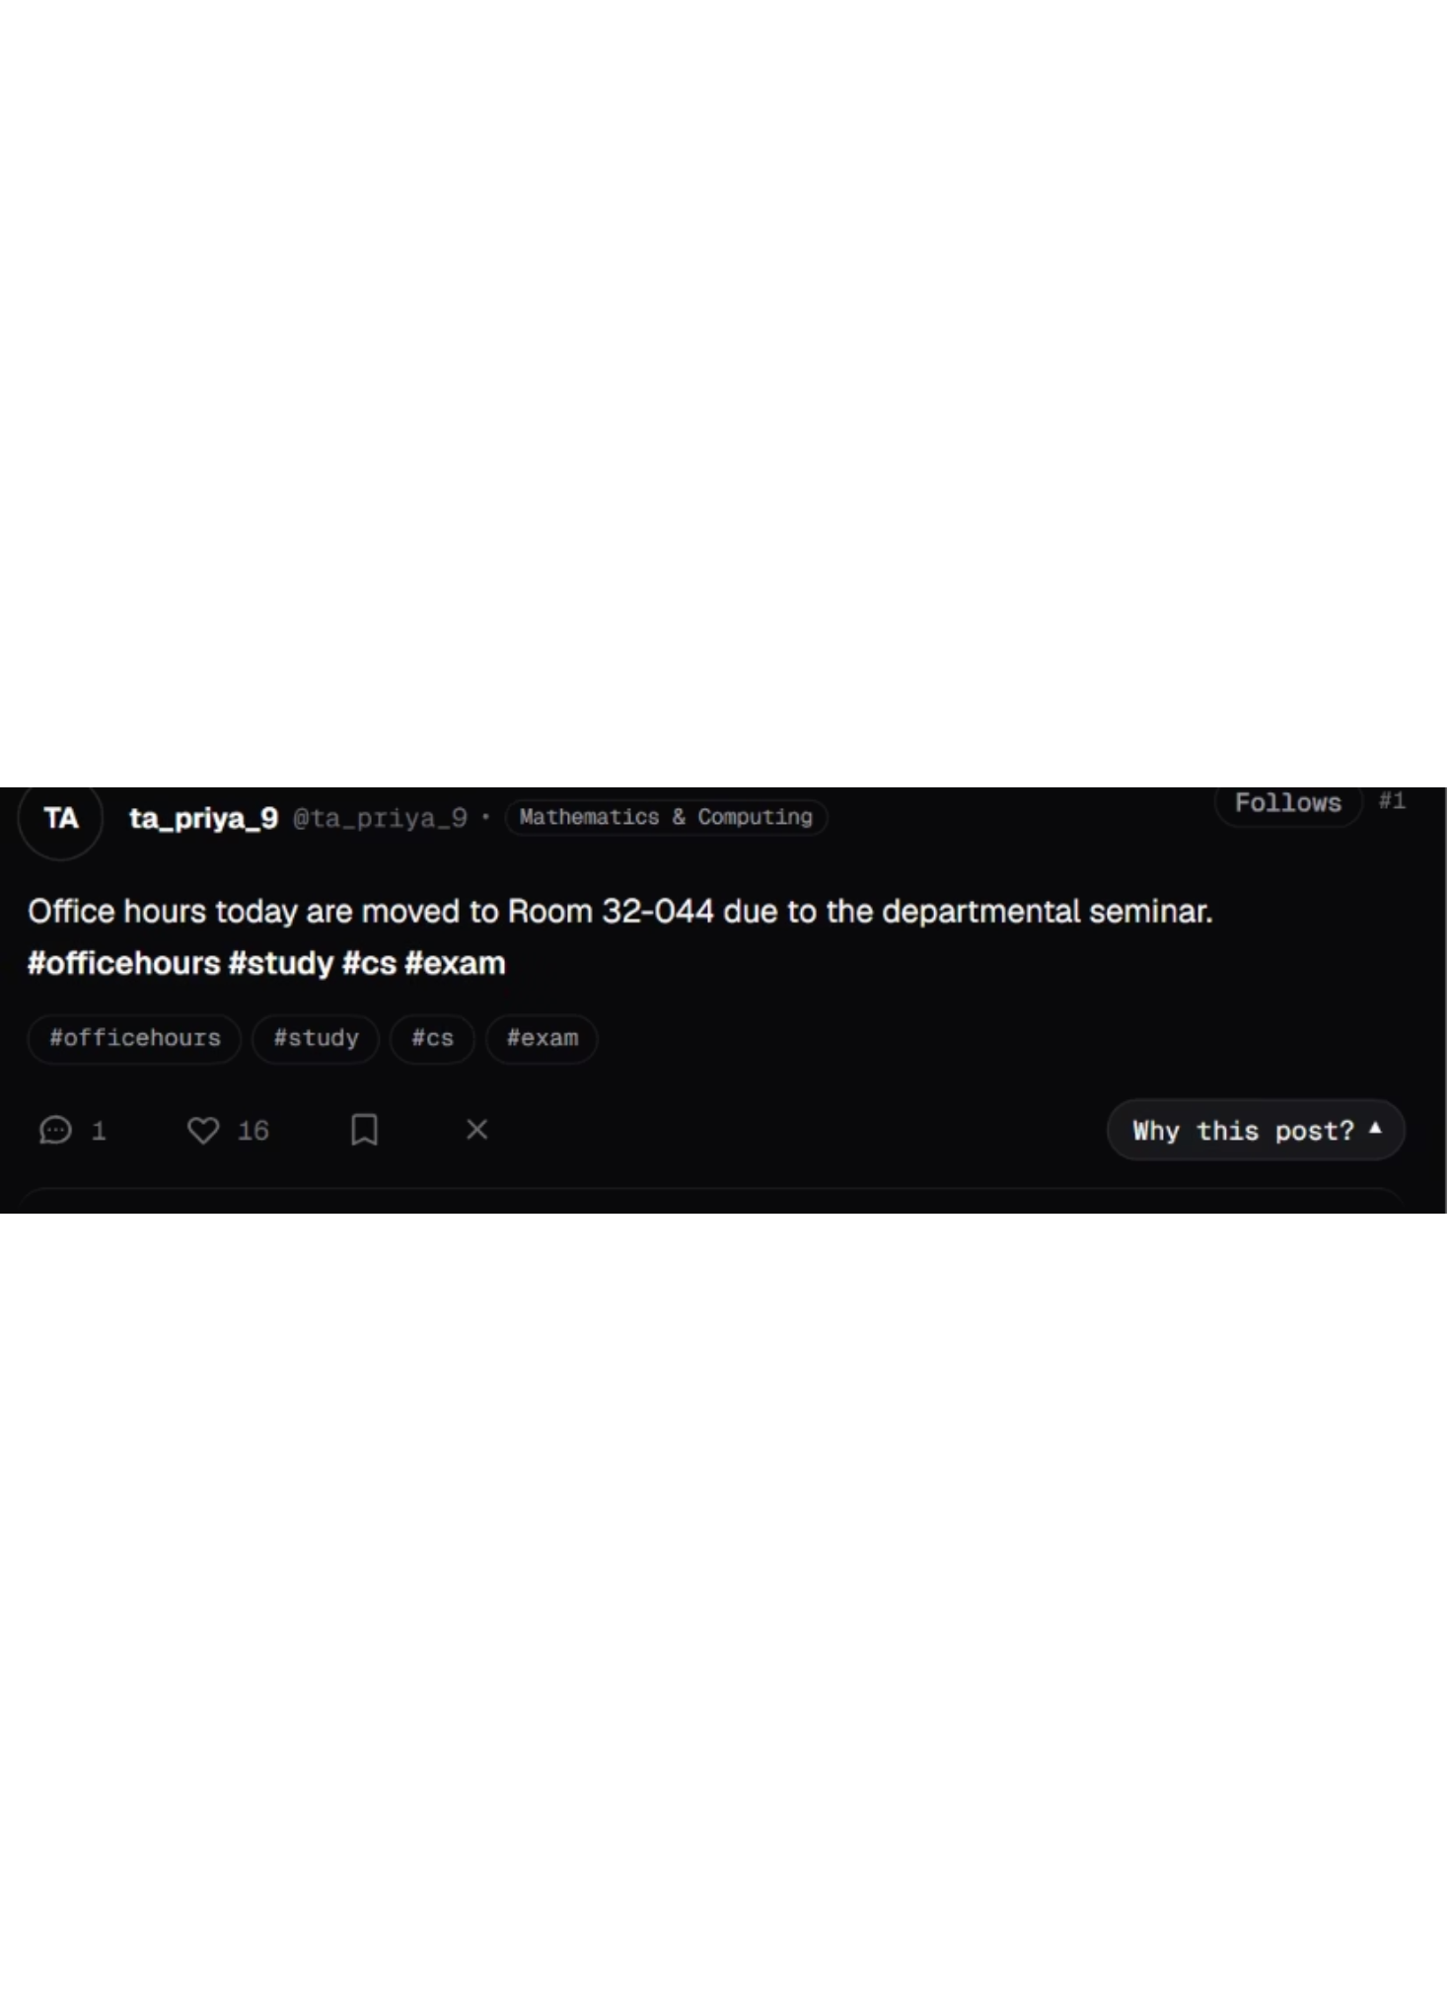
IMPLICIT FEEDBACK FORMULATION
Learning from likes and skips: a like counts 41x more than silence
Over 99% of feedback is implicit. Unseen posts represent missing data rather than negative sentiment, while quick skips indicate disinterest.
Meaning: a post the student engaged with gets a much larger weight than an unseen post (weight 1).
LIKE
REPLY
BOOKMARK
SKIP (<1.5S)
+1.0
+2.0
+1.5
−0.5
TECHNICAL REPORT · REV A
05 / 10
Notes:
Emphasize the asymmetry of implicit feedback: silence is not dislike. With this confidence weight, zero engagement still retains a baseline confidence of 1, while deliberate interaction amplifies confidence 41-fold.

Slide 6
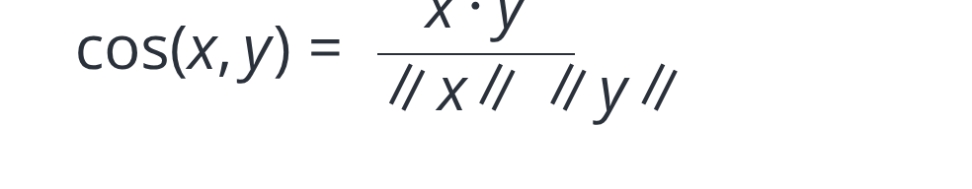
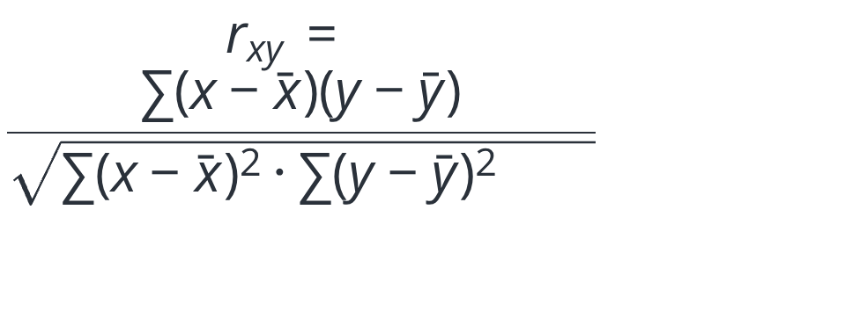
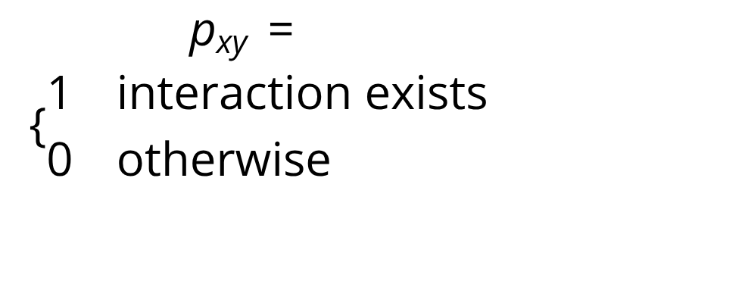
SIMILARITY METRICS
Three ways to measure "similar", each used where it fits
POST CONTENT SIMILARITY
STUDENT-TO-STUDENT (K = 20)
LATENT TASTE EMBEDDINGS
Cosine Similarity
Pearson Correlation
Implicit ALS (iALS)
Meaning: compares topic vectors of two posts by angle, regardless of length.
Meaning: how similarly two students rate posts after removing each one's average.
Meaning: iALS treats each observed interaction as a 1 and every missing post as a 0.
TECHNICAL REPORT · REV A
06 / 10
Notes:
Compare the three mathematical foundations: Cosine handles text vectors, Pearson handles explicit neighborhood normalization with significance weighting, and iALS solves the 98.7% sparsity problem where standard SVD fails.

Slide 7
COLD-START STRATEGY
New students take a different route
WARM PATH (YES)
COLD PATH (NO)
iALS collaborative path
Content path
TF-IDF over post text, departments and hashtags like #cs and #hackathon; student profile = average of posts they liked.
INPUT
DECISION GATE
Personalized latent factor matching
New Request
→
3 or more interactions?
YES / NO
Student session starts
Threshold for collaborative fit
Both paths → ranker
BASELINE COLD NDCG@10
TAG-BOOSTED COLD NDCG@10
RELATIVE IMPROVEMENT
0.0109
0.6719
+61.6x
TECHNICAL REPORT · REV A
07 / 10
Notes:
Highlight the dramatic cold-start jump: fallback content routing raises NDCG@10 from 0.0109 to 0.6719 (a 61.6x increase) by leveraging department tags and liked-post centroids.

Slide 8
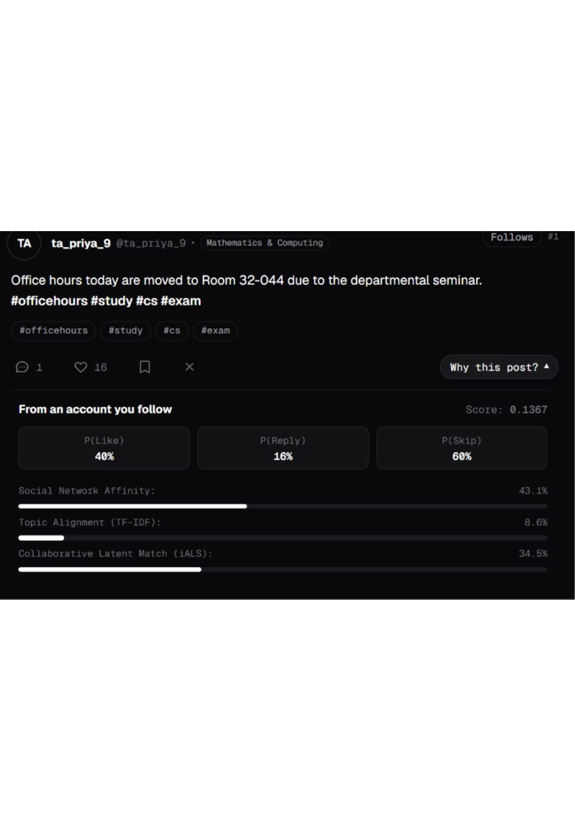


SCORING & RANKING
The ranker predicts three behaviours, then scores the post
12-number vector → P(Like), P(Reply), P(Skip) → weighted utility → recency decay → score.
Meaning: weighted expected engagement, discounted as the post ages (Δt in hours).
P(LIKE) / P(REPLY) / P(SKIP)
RAW SCORE · 15H DECAY
RECORDED SCORE
0.1367
40% · 16% · 60%
0.192 ·
Feature breakdown: Social affinity 43.1% · iALS match 34.5% · Topic alignment 8.6%.
TECHNICAL REPORT · REV A
08 / 10
Notes:
In the screenshot example, 0.192 × 0.7408 is approximately 0.1422, not 0.1367. Show the screenshot's recorded score, 0.1367, and flag the mismatch.

Slide 9
DIVERSITY & FAIRNESS
MMR keeps the feed from becoming ten posts about midterms
Maximal Marginal Relevance balances greedy utility ranking against topic saturation and author clustering.
Meaning: pick posts that are relevant but not too similar to ones already chosen (x = candidate, y = selected post).
1. SORT CANDIDATES
2. PENALIZE SIMILARITY
3. AUTHOR CAP
Rank by Raw Score
Subtract Cosine Overlap
Max 2 Posts / Author
High-utility candidates sorted descending
Discount posts resembling already-selected items
Prevents power-users from dominating
FEED DIVERSITY
PRECISION@10 IMPACT
0.915 → 0.962
0.0%
+5.1% intra-list variety gain
Zero degradation in top-10 relevance
TECHNICAL REPORT · REV A
09 / 10
Notes:
Explain why MMR is necessary: pure greedy ranking bunches similar posts (e.g. 5 consecutive exam complaints). With lambda = 0.70, diversity climbs 5.1% to 0.962 without hurting precision.

Slide 10
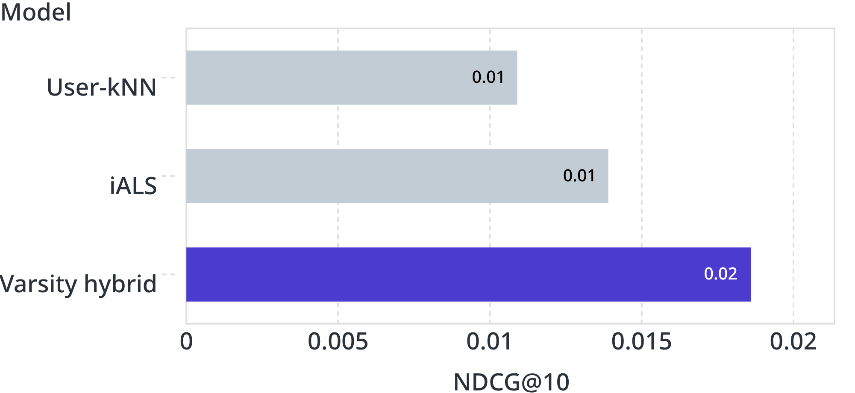
EVALUATION BENCHMARK
The hybrid beats every single model
OFFLINE ACCURACY: NDCG@10 (80/20 TEMPORAL SPLIT)
PRODUCTION METRICS
Precision@10 | 0.0120
Recall@10 | 0.0156
Catalog Coverage | 10.0%
Feed Diversity | 0.9599
Evaluated across 8 baseline configurations on an 80/20 time-based split. Security includes Jaccard botnet graph filtering.
Key references: X Corp. (2023) The Algorithm; Sarwar et al. (2001) Item-Based CF; Mobasher et al. (2007) Shilling Attacks.
TECHNICAL REPORT · REV A
10 / 10
Notes:
Conclude with the overall benchmark: the multi-stage hybrid achieves 0.0186 NDCG@10, outperforming standalone iALS (0.0139) and user neighborhood methods (0.0109), while maintaining a 0.9599 diversity score.

